Slide 1
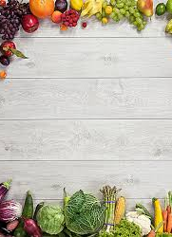
FOOD STORAGE PREDICTION
prepared BY:
ashok - 2451-17-737-019
Ibrahim - 2451-17-737-022
Vaseem - 2451-17-737-023
guided by:
mr. P. Karthik(Asst. prof)

Slide 2
Contents
Abstract
Introduction
Problem statement
Software and Hardware requirements
Implementation
Algorithm used
System Design
Testing
Screen Shots and Results
Conclusion
Future scope

Slide 3
ABSTRACT:
The objective of this system is to predict the number of days till the food becomes stale based on certain parameters. This type of prediction requires the knowledge of ingredients the food is made up of and the weather condition in which the food is going to be stored. This system is developed for finding the expiry date of the product. All the required data will be stored in a database. The software will be developed using R language and the result will be displayed in graphical format with respect to the time.

Slide 4
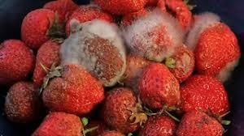
INTRODUCTION
The project is made for predicting the number of days the food will last. Different factors like temperature, time of preparation, season, state of the food item(dry or wet) is taken into consideration before predicting the number of days the food will last. It is not easily available to the users as an application on their phones. Preservatives if any present is not taken into consideration and the dataset contains only limited ingredients.

Slide 5
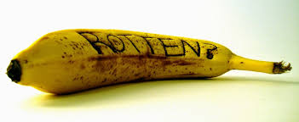
PROBLEM STATEMENT:
People often get to know that a food is stale after it starts smelling or after they taste it. Sometimes they don’t even get to know that a food has become stale and they eat it which causes food poisoning to them or other kinds of illness. To prevent such things from happening this project has been made. We interpret the expiry time of the food item taking into account the different conditions encountered during the preparation and storage of the food item.

Slide 6
SOFTWARE AND HARDWARE REQUIRED:
SOFTWARE:
Technology : R programming
OS : Windows 7
Platform : R Studio, R Console, Excel
HARDWARE:
Processor : Intel core i3
RAM : 4GB
ROM : 20 GB

Slide 7
Implementation
At the beginning the Data sheet of the data should be collected and should be saved as csv Extension.
The data is collected with different factors like storing temperature, time of preparation, season, state of food. Data Includes two ingredients i.e., main and side ingredients.
Necessary libraries are installed such as caTools, for multiple linear regression model and ggplot2, for the graph/plot of the trained dataset.
All the lines in the data sheet which is saved as csv extension all allotted to train except the last line which is allotted for the prediction of the Expiry.

Slide 8
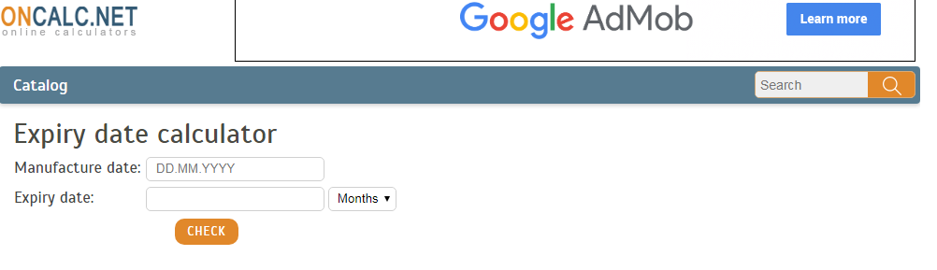
Existing systems
The problem with the existing system
is that we cannot predict the expiry
date of different cooked products and
they do not take into consideration the
environmental factors like season,
temperature, time of preparation,
and the state of food.

Slide 9
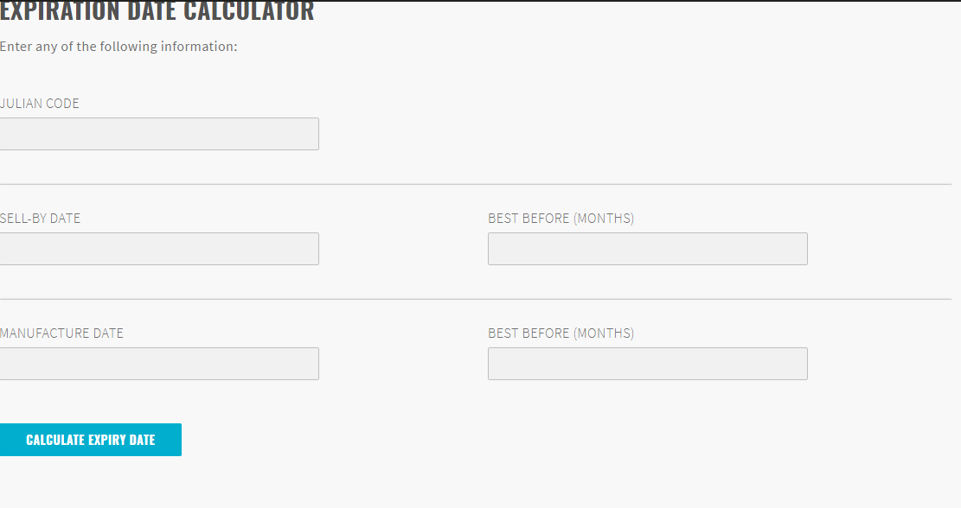
From both figures we can see that
the expiry date is calculated by entering
the manufacturing date and sell date only,
there is no additional features and it is
limited to sales product only.

Slide 10
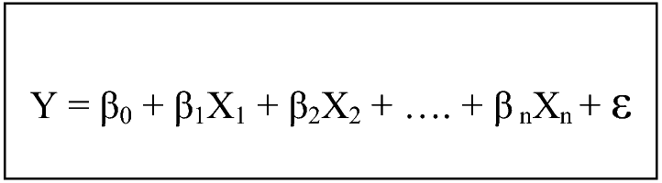
Algorithm used:
Multiple linear regression-
Multiple linear regression (MLR), also known simply as multiple regression, is a statistical technique that uses several explanatory variables to predict the outcome of a response variable. The goal of multiple linear regression (MLR) is to model the linear relationship between the explanatory (independent) variables and response (dependent) variable.
Syntax : lm(formula~cost.,dataset)

Slide 11
SYSTEM DESIGN:
PREPARING THE DATASET
PREPROCES--SING THE DATASET
SPLITTING THE DATASET
TRAINING THE MODEL
EVALUATING THE TEST SET
PLOTTING THE DATASET TO GRAPH

Slide 12
Testing:
For testing this project the dataset is the training set and the dataset(input) taken from the user is the test set.
The model is trained with respect to the training set.
The input is predicted with the model prepared by using predict().
We can get the summary of our model by using summary().

Slide 13
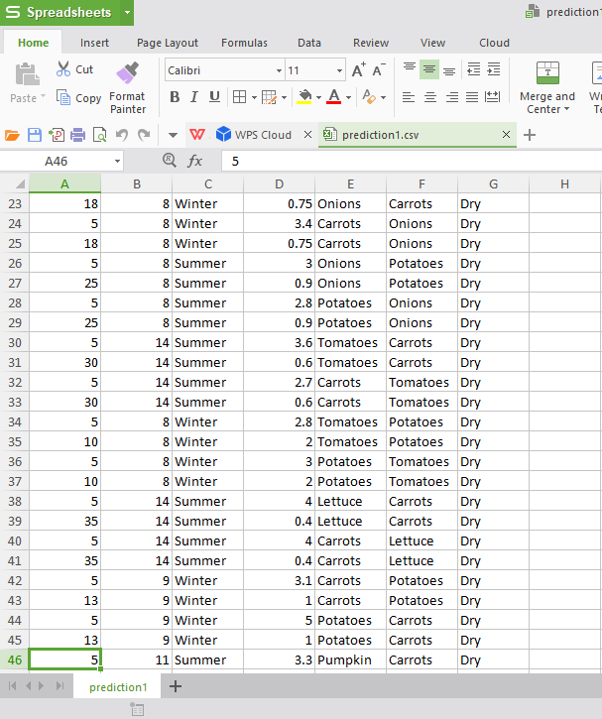
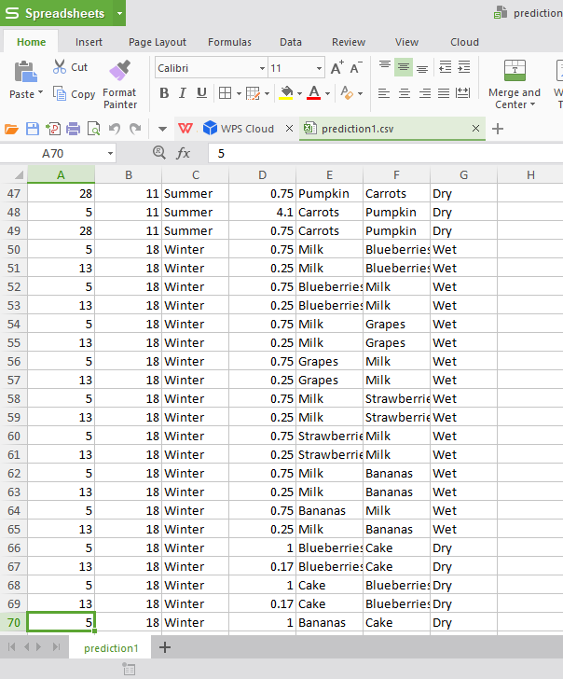
Screenshots
Screenshots of the Dataset

Slide 14
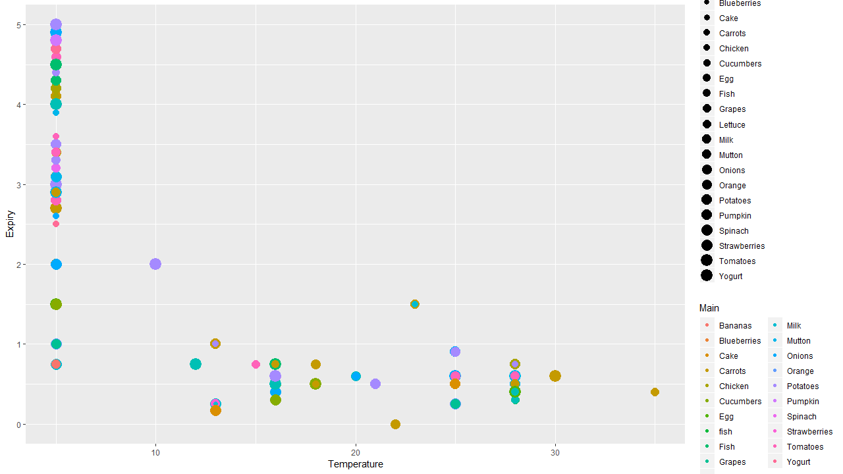
Result:

Slide 15
Input:
OUTPUT:

Slide 16
Conclusion:
This project was developed with the aim of helping people living in hostels or away from their families who don’t have knowledge about the lifetime of foods. It will save people’s time and make their lives simpler. This project takes different factors into account and then predicts so it is more efficient. It minimizes efforts and saves time.

Slide 17
FUTURE SCOPE:
The dataset can be further extended to many more ingredients like dals and spices. Now only main and side item is taken into account more number of ingredients can be taken into consideration at the same time. Things like salt and other preservatives increase the life time of the food products which can also be included. The project can be converted into an application so that it is more easily available to everyone.

Slide 18
references
www.ggplot2.tidyverse.org
www.tutorials.iq.harvard.edu/R/Rgraphics/Rgraphics.html
www.sphweb.bumc.bu.edu/otlt/MPH-Modules/BS/BS704_Multivariable/BS704_Multivariable7.html
www.investopedia.com/terms/m/mlr.asp
https://www.udemy.com/machinelearning/learn/v4/t/lecture/5734728?start=90
https://www.udemy.com/r-programming/learn/v4/overview

Slide 19
Thank you ☺
Stay home 🏡 Stay safe

